Slide 2
raising awareness of a struggling population
ALICE (Asset Limited, Income Constrained, Employed) represents those who are working but struggle to afford the basic necessities of life.
Right here in Greater Houston, more than one million households are struggling to make ends meet.
14% of households across Greater Houston are living on wages below the federal poverty threshold
+
31% more households are working hard but can’t afford the basic necessities of life
Notes:
United Way’s work is focused on lifting up those living on wages below the federal poverty level and those who are experiencing ALICE. ALICE stands for Asset Limited, Income Constrained, Employed, and represents families that are working, but are unable to afford the basic necessities of housing, food, child care, health care, and transportation.​
The ALICE Report, a research study that uses real costs of things like food, housing, and transportation, in our area to determine what it actually takes to get by and how many people struggle to afford those necessities, tells us that, right here in Greater Houston, 14% of households are living on wages below the poverty level and another 31% are working hard but cannot afford the basic necessities of life.
That means over a million households in Greater Houston are struggling to make ends meet.
The ALICE Report offers a detailed look at the income needed for an average household in our region to make ends meet. A family of three (a single parent with preschooler and school-aged child) needs $63,204 for monthly necessities. This income takes into account the cost of housing, child care, transportation, food, taxes, health care, miscellaneous expenses, and technology. (You can see budgets for different household sizes and compositions across our region at unitedwayhouston.org/alice)
Those experiencing ALICE may be hidden in plain sight - your child care worker, the cashier at your supermarket, a home health aide, an office clerk. They are often forced to make tough choices, such as deciding between quality child care or paying the rent, which have long-term consequences not only for their families, but for us all.
These tough choices can have long-term consequences for a family – children not being fully prepared to start and succeed in school or not getting adequate nutrition. For our community as a whole, the impact can be seen when parents are unable to work, the future workforce is less prepared, or even the increased public health costs.
Some of the challenges ALICE faces:​
ALICE households have few means to change the educational trajectory that places low-income students in poorer quality schools and increases their risk for not graduating high school or attending college.
Having enough food is a basic challenge for ALICE households. Chronic food insecurity leads to less healthy eating and increased stress, both of which contribute to poor health.
Families experiencing ALICE face circumstances that make it difficult for them to achieve and maintain good health. When health issues go untreated, they become more serious and more costly, and lead to other poor outcomes.
ALICE households struggle to afford day-to-day expenses, making it nearly impossible to save for emergencies or future financial goals. Without savings, ALICE is vulnerable to unexpected emergencies and ongoing financial hardships.
The ALICE data has helped us get a clearer picture of how many of our neighbors are struggling, what the needs are, and how we can best support our neighbors and our community.
The challenges our neighbors face are interconnected, and the solutions should be, too. That’s why we personally guide families and individuals who are ready, helping them access multiple services on their unique financial stability journey.
And we can’t do it without you. United, we can do so much more than we can do on our own to help our neighbors not only land on their feet but stay there.

Slide 3
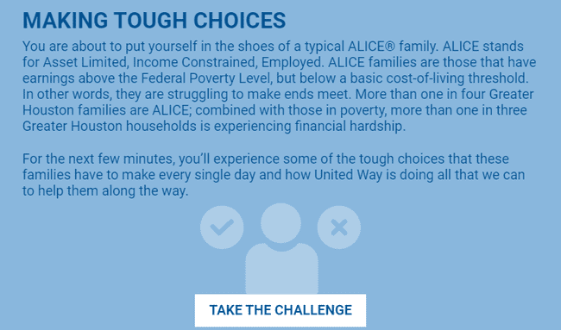
making tough choices – take the challenge
access the challenge
http://uwgh.makingtoughchoices.org/
*If you want to track employee participation, contact your United Way representative to get a company-specific link that will ask participants to enter their information before beginning the challenge.

Slide 4
suggested format/flow
30-45 minute Zoom Meeting for small or large groups
Provide overview of ALICE and the challenge in Main Session
Breakout to smaller groups
5-10 participants each
One Facilitator needed per breakout room
Share their screen and open the challenge
Read the intro, questions and conclusion aloud to the group
Lead the discussion and click through the choices
Rejoin the main session
Quick overview of how United Way is helping ALICE
Group Discussion Questions
Watch ALICE video to conclude

Slide 5
sample meeting agenda
Time | Activity
5 – 10 minutes | Introductions and explanation of challenge
15 – 20 minutes | Take challenge in breakout rooms
5 – 15 minutes | Wrap-up, play video, and have discussion

Slide 6
breakout rooms
We recommend setting a time limit on the breakout session so participants automatically rejoin the main session
Make sure to enable breakout rooms when you set up your meeting
You can pre-assign participants to breakout rooms when you schedule the meeting or manage them during the meeting
Only the host can assign participants to breakout rooms

Slide 7
help with breakout rooms
Learn how to create and manage breakout rooms here: https://support.zoom.us/hc/en-us/articles/206476313-Managing-breakout-rooms
Watch a quick tutorial here: https://youtu.be/jbPpdyn16sY

Slide 8
how does united way help ALICE?
We recommend that the meeting facilitator review this immediately upon returning to the main session.
United Way creates a pathway to self-sufficiency and success by providing tools, resources, and support to help hardworking individuals and families obtain financial stability and a sustainable quality of life
United Way supports families on the path to financial stability through financial coaching and education, job training, savings and credit building, safe and affordable financial products, and more
United Way provides safety net programs that help people take care of their basic and immediate needs, like food, shelter, and transportation, help people escape from violent situations, like domestic violence, and serve other vulnerable populations, like refugees
United Way provides additional support to families working to achieve stability through early childhood and youth development programs, and physical and behavioral health care programs
Unites Way operates the 211 Texas/United Way HELPLINE, staffed with specialists accessing our community’s largest, most up-to-date database of social services, 24/7/365 to help those in need access help
United Way convenes and leads long-term recovery efforts when our community faces disaster, like Hurricane Harvey, COVID-19, and the February 2021 winter storm

Slide 9
discussion questions
We recommend posting at least one discussion question to the breakout group in case the group finishes early. The remaining questions can be discussed in the main session.
Will 2-3 people volunteer to share their experience going through the simulation?
What part of the experience surprised you?
What decision did your group struggle with the most?
Any take-aways that resonated with you?

Slide 10
wrap up video
ALICE Video (2 min 50 sec)
Available to download here (titled Who is Alice?)
Make sure to share your computer sound
Screenshot on next slide

Slide 11
instructions to share computer audio

