Slide 2
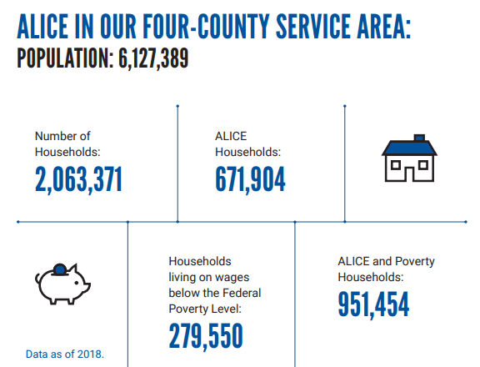
raising awareness of a struggling population
ALICE (Asset Limited, Income Constrained, Employed) represents those who are working but struggle to afford the basic necessities of life.
14% of households across Greater Houston are living on wages below the federal poverty threshold
+
33% more households are working hard but can’t afford the basic necessities of life
Notes:
United Way’s work is focused on lifting up those living on wages below the federal poverty level and those who are experiencing ALICE. ALICE stands for Asset Limited, Income Constrained, Employed, and represents families that are working, but are unable to afford the basic necessities of housing, food, child care, health care, and transportation.​
Those experiencing ALICE may be hidden in plain sight - your child care worker, the cashier at your supermarket, a home health aide, an office clerk. They are often forced to make tough choices, such as deciding between quality child care or paying the rent, which have long-term consequences not only for their families, but for us all.
​
ALICE households hold jobs, pay taxes, and provide services that are vital to the Texas economy. ALICE workers primarily hold jobs in occupations that build and repair our infrastructure and educate and care for the workforce. ALICE is your child care worker, a recent graduate who can’t find work in their field, the cashier at your supermarket, the salesperson at your big box store, a home health aide, an office clerk. ​
​
The ALICE Report for Texas is a county-by-county look at what it actually takes to make ends meet and how many families are really struggling to get by. ​
​
A family of four, including two children in child care, in the Greater Houston Area, needs approximately $79,000/year to take care of their basic needs. Of course, that amount differs depending on the size and composition of a family. You can see what it takes for more family compositions to get by at unitedforalice.org/texas. ​
​
In our community, 14% of families are surviving on incomes below the Federal Poverty Level, and another 33% are employed, but struggling to afford necessities, like food, housing, and health care.
​
Some of the challenges ALICE faces:​
ALICE households have few means to change the educational trajectory that places low-income students in poorer quality schools and increases their risk for not graduating high school or attending college.
Having enough food is a basic challenge for ALICE households. Chronic food insecurity leads to less healthy eating and increased stress, both of which contribute to poor health.
Families experiencing ALICE face circumstances that make it difficult for them to achieve and maintain good health. When health issues go untreated, they become more serious and more costly, and lead to other poor outcomes.
COVID-19 and the related economic crisis increased the number of households that are experiencing ALICE and made life even tougher for those who are already experiencing ALICE.
ALICE households struggle to afford day-to-day expenses, making it nearly impossible to save for emergencies or future financial goals. Without savings, ALICE is vulnerable to unexpected emergencies and ongoing financial hardships.
​
​The ALICE data has helped us get a clearer picture of how many of our neighbors are struggling, what the needs are, and how we can best support our neighbors and our community.

Slide 3
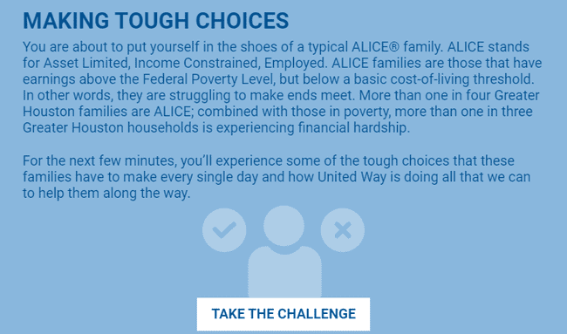
making tough choices – take the challenge
access the challenge
http://uwgh.makingtoughchoices.org/
*If you want to track employee participation, contact your United Way representative to get a company-specific link that will ask participants to enter their information before beginning the challenge.

Slide 4
suggested format/flow
30-45 minute Zoom Meeting for small or large groups
Provide overview of ALICE and the challenge in Main Session
Breakout to smaller groups
5-10 participants each
One Facilitator needed per breakout room
Share their screen and open the challenge
Read the intro, questions and conclusion aloud to the group
Lead the discussion and click through the choices
Rejoin the main session
Quick overview of how United Way is helping ALICE
Group Discussion Questions
Watch ALICE video to conclude

Slide 5
sample meeting agenda
Time | Activity
5 – 10 minutes | Introductions and explanation of challenge
15 – 20 minutes | Take challenge in breakout rooms
5 – 15 minutes | Wrap-up, play video, and have discussion

Slide 6
breakout rooms
We recommend setting a time limit on the breakout session so participants automatically rejoin the main session
Make sure to enable breakout rooms when you set up your meeting
You can pre-assign participants to breakout rooms when you schedule the meeting or manage them during the meeting
Only the host can assign participants to breakout rooms

Slide 7
help with breakout rooms
Learn how to create and manage breakout rooms here: https://support.zoom.us/hc/en-us/articles/206476313-Managing-breakout-rooms
Watch a quick tutorial here: https://youtu.be/jbPpdyn16sY

Slide 8
how does united way help ALICE?
We recommend that the meeting facilitator review this immediately upon returning to the main session.
United Way is creating a pathway to self-sufficiency and success by providing tools, resources, and support to help hardworking individuals and families obtain financial stability and a sustainable quality of life
United Way supports families on the path to financial stability through financial coaching and education, job training, savings and credit building, safe and affordable financial products, and more
United Way provides safety net programs that help people take care of their basic and immediate needs, like food, shelter, and transportation, help people escape from violent situations, like domestic violence, and serve other vulnerable populations, like refugees
United Way provides additional support to families working to achieve stability through early childhood and youth development programs, and physical and behavioral health care programs
Unites Way operates the 211 Texas/United Way HELPLINE, staffed with specialists accessing our community’s largest, most up-to-date database of social services, 24/7/365 to help those in need access help
United Way convenes and leads long-term recovery efforts when our community faces disaster, like Hurricane Harvey, COVID-19, and the February 2021 winter storm

Slide 9
discussion questions
We recommend posting at least one discussion question to the breakout group in case the group finishes early. The remaining questions can be discussed in the main session.
Will 2-3 people volunteer to share their experience going through the simulation?
What part of the experience surprised you?
What decision did your group struggle with the most?
Any take-aways that resonated with you?

Slide 10
wrap up video
ALICE Video (2 min 50 sec)
Available to download here (titled Who is Alice?)
Make sure to share your computer sound
Screenshot on next slide

Slide 11
instructions to share computer audio

